Slide 1
Grocery Store's Market Basket Analysis
Hemant Patidar
26-06-2022

Slide 2
Analysis Steps
Exploratory Analysis
Data detailing with shape, stats along with Univariate & Bivariate analysis.
Market Basket Analysis (Association Rules)
Basket Analysis with Association rules
Associations Identified
Prediction of products based on purchased or gather in the basket
Inferences from RFM Analysis and identified segments
Possible Combos with Lucrative Offers

Slide 3
Exploratory data Analysis & Executive Summary
EDA helps identify errors in data sets. Gives a better understanding of the data set. Helps detect outliers or anomalous events. Helps understand data set variables and the relationship among them.

Slide 4
Data Stats
Exploratory data Analysis & Executive Summary
Shape
Data Information
Numbers of Rows: 20641
Number of Fields/Columns: 3
Date time: 1
Numeric: 1 (Order ID)
Categorical/Object: 1 (product)
NULL or Duplicates
Data has NO null values
Data has 4730 duplicate rows
Dataset has 1139 unique Orders

Slide 5
Assumptions
Exploratory data Analysis & Executive Summary
Multiple rows together represent all items purchased in an Order
Single product can be purchased multiple times and cause duplication
We have 37 unique products being purchased, “All-Purpose” doesn’t specify any product hence we will drop that.
To align all values correctly, Product names has been adjusted to capitalized

Slide 6
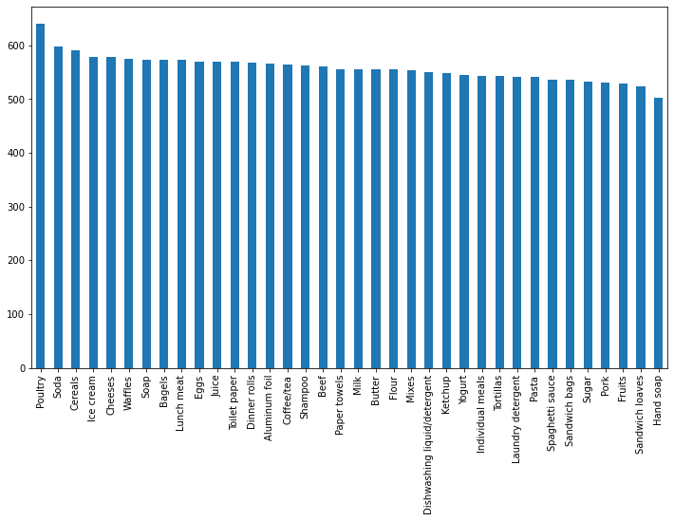
Exploratory data Analysis & Executive Summary
Product Analysis
INTERFERENCE
“Poultry” was purchased most number of times (640)
“Hand soap” was purchased lesser compared to all other products (502 times)
All products were purchased significantly in orders (500 – 600 times of 1149 orders)

Slide 7
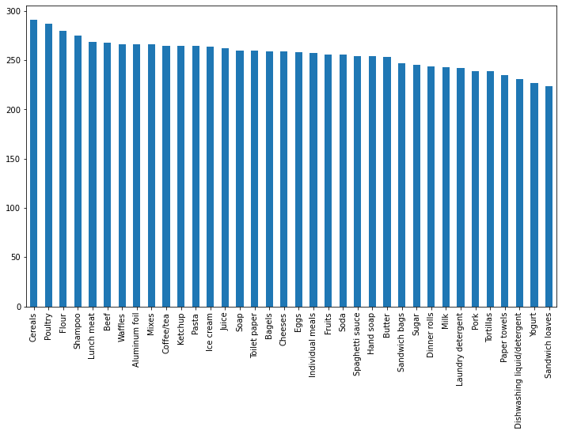
Exploratory data Analysis & Executive Summary
Trend Analysis (Products In 2018)
INTERFERENCE
Top 3 products purchase in 2018 were
Cereals
Poultry
Flour
Bottom 3 purchases in 2018 were
Sandwich loaves
Yogurt
Dishwashing liquid/detergent

Slide 8
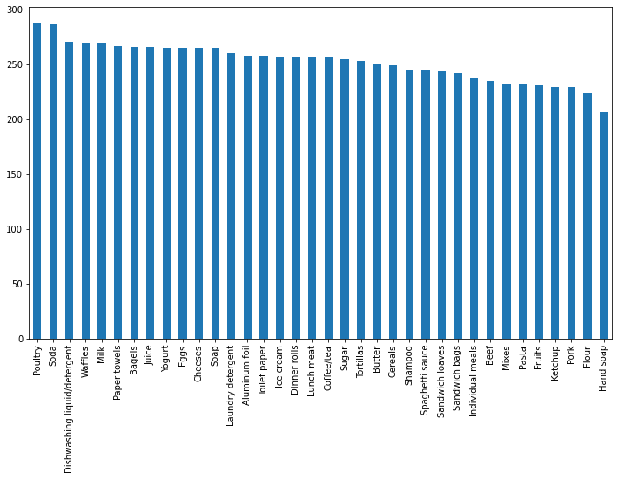
Exploratory data Analysis & Executive Summary
Trend Analysis (Products In 2019)
INTERFERENCE
Top 3 products purchase in 2019 were
Poultry
Soda
Dishwashing liquid/detergent
Bottom 3 purchases in 2019 were
Hand soap
Flour
Pork

Slide 9
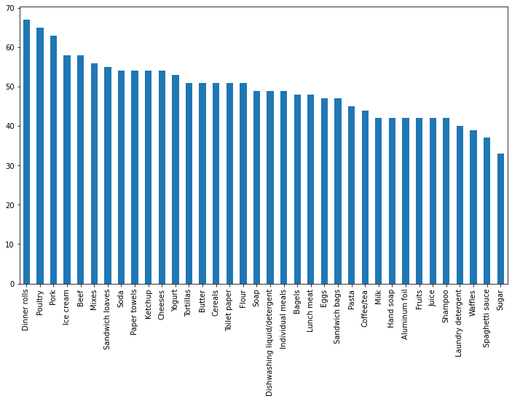
Exploratory data Analysis & Executive Summary
Trend Analysis (Products In 2020)
INTERFERENCE
Top 3 products purchase in 2020 were
Dinner rolls
Poultry
Pork
Bottom 3 purchases in 2020 were
Sugar
Spaghetti sauce
Waffles

Slide 10
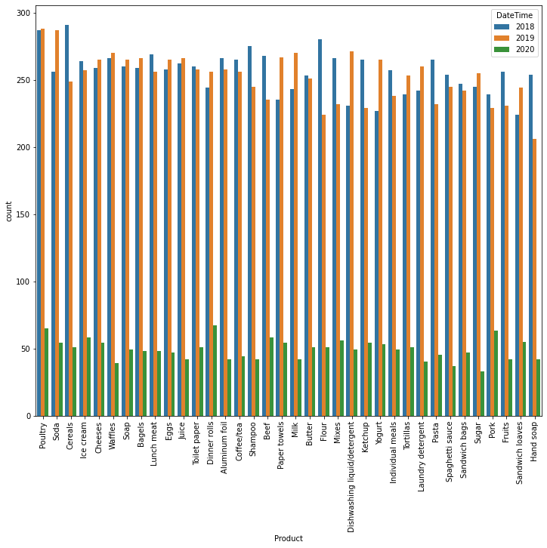
Exploratory data Analysis & Executive Summary
Product Analysis vs. Purchase Year
INTERFERENCE
“Poultry’s” purchase gone up in 2019 compared to 2018
“Hand Soup’s” purchase gone down in 2019 with significant number
“Soda’s” Purchase was increased in 2019
“Poultry” was always in trend
2nd top purchased in 2018
Top purchased in 2019
2nd top purchased in 2020
“Poultry” was mostly purchased in January, followed by February then April.

Slide 11
Use of Market Basket Analysis (Association Rules)
This process identifies customer buying habits by finding associations between the different items that customers place in their “shopping baskets”

Slide 12
What Is Association rule?
Use of Market Basket Analysis (Association Rules)
“Association Rule” would help us recommend frequent bought item based on already bought items.
Assumptions –
“I” be itemset {I1,I2,I3…. In}
“D” a dataset of transactions
“T” represent each transaction of non-empty itemset such as T ⊆ I (T has purchased item that are subset to I)
Each transaction is associated with an identifier “TID”
If “A” be a set of items (itemset) and “B” would be predicted based on “A”
Association Rules Stats that –
A ⇒ B, where A ⊂ I, B ⊂ I, A ⊆ T and A ∩B = φ

Slide 13
What Is Association rule?
Use of Market Basket Analysis (Association Rules)
Support
Confidence
lift
support(A⇒ B) =P(A ∪ B)
The percentage of transactions in D that contain A ∪ B is called Support.
confidence(A⇒ B) =P(B|A)
The percentage of transactions in D containing A that also contains B. This is taken to be confidence and the conditional probability, like P(B|A).
Confidence/support
Lift is the ratio between target response and average response

Slide 14
Apriori Terminology
Use of Market Basket Analysis (Association Rules)
Apriori algorithm uses frequent itemsets to generate association rules. It is based on the concept that a subset of a frequent itemset must also be a frequent itemset. Frequent Itemset is an itemset whose support value is greater than a threshold value(support).
Antecedent
Consequent
Conviction
Leverage
(IF Bought)
This is an item/group of items that are typically found in the Itemsets or Datasets. (Already Purchased)
(THEN Suggest)
This comes along as an item with an Antecedent/group of Antecedents.
Conviction is a measure of the implication and has value 1 if items are unrelated.
Leverage is the proportion of additional elements covered by both the premise and consequence above the expected if independent

Slide 15
Support & Confidence threshold
Use of Market Basket Analysis (Association Rules)
Association rule can recommend items based on rare purchases as well, which may not be a good suggestion for buyer/customer. Support and confidence are metrices that helps suggesting a better purchase to them.
Support
Confidence
Support provides us % of transactions contains our recommended product, rare the purchase support would be lower.
To back our suggest with good support, we can choose it to be atleast 20%.
For our analysis, we will be putting support (for suggested product) as 20%
Confidence derived as percentage of transactions in D containing A that also contains B.
For our analysis, we will be recommending products with atleast 30% confidence.

Slide 16
Associations Identified
This process identifies customer buying habits by finding associations between the different items that customers place in their “shopping baskets”

Slide 17
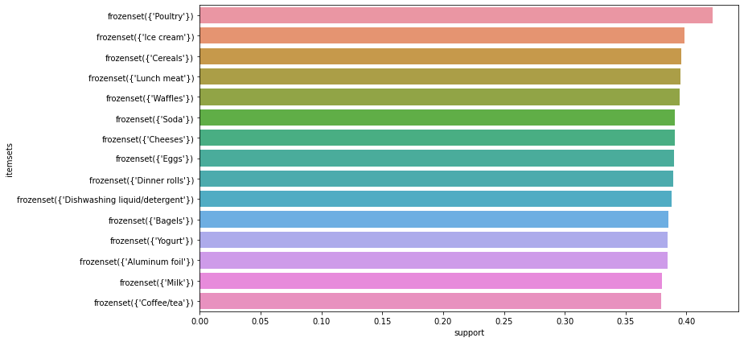
Associations Identified
Support identified by Apriori (Top 15)

Slide 18
Associations Identified
Associations Identified
antecedents | consequents | antecedent support | consequent support | support | confidence | lift | leverage | conviction
(Dinner rolls, Spaghetti sauce, Ice cream) | (Poultry) | 0.0755 | 0.4214 | 0.0518 | 0.6860 | 1.6279 | 0.0200 | 1.8429
(Cereals, Sandwich bags, Bagels) | (Cheeses) | 0.0755 | 0.3907 | 0.0509 | 0.6744 | 1.7262 | 0.0214 | 1.8714
(Laundry detergent, Dinner rolls, Spaghetti sa... | (Poultry) | 0.0817 | 0.4214 | 0.0536 | 0.6559 | 1.5564 | 0.0191 | 1.6815
(Eggs, Pasta, Ice cream) | (Paper towels) | 0.0852 | 0.3626 | 0.0553 | 0.6495 | 1.7912 | 0.0244 | 1.8185
(Eggs, Paper towels, Ice cream) | (Pasta) | 0.0860 | 0.3714 | 0.0553 | 0.6429 | 1.7310 | 0.0234 | 1.7601
(Laundry detergent, Spaghetti sauce, Poultry) | (Dinner rolls) | 0.0834 | 0.3889 | 0.0536 | 0.6421 | 1.6509 | 0.0211 | 1.7074
(Spaghetti sauce, Poultry, Ice cream) | (Dinner rolls) | 0.0808 | 0.3889 | 0.0518 | 0.6413 | 1.6489 | 0.0204 | 1.7036
(Aluminum foil, Yogurt, Toilet paper) | (Juice) | 0.0781 | 0.3766 | 0.0500 | 0.6404 | 1.7004 | 0.0206 | 1.7337
(Cereals, Dinner rolls, Spaghetti sauce) | (Poultry) | 0.0799 | 0.4214 | 0.0509 | 0.6374 | 1.5124 | 0.0173 | 1.5955
(Dinner rolls, Pasta, Paper towels) | (Eggs) | 0.0817 | 0.3898 | 0.0518 | 0.6344 | 1.6275 | 0.0200 | 1.6690

Slide 19
Associations Identified
Support, Confidence, & Lift Calculation
Support Calculation –
Defined as ratio of (Total transactions having items A+B) / (Total transactions)
Example –
On 1st records with highest confidence, we have –
A → Antecedents as (Dinner rolls, Spaghetti sauce, Ice cream)
B → Consequents as (Poultry)
and support was calculated as 0.0518
If we check all 4 items in single order against all transactions, customers have purchased them in 59 transactions whereas total number of transactions (orders) are 1139.
Hence support would be 59/1139 → 0.05179 ~ 0.0518
Confidence Calculation –
Defined as ratio of (Total transactions having items A+B)/ (Total transactions having A)
With above example –
We have transactions with all 4 items are -> 59
transaction with only items (X – Antecedents) are -> 86
Hence confidence would be 59/86 → 0.68

Slide 20
Associations Identified
Support, Confidence, & Lift Calculation
Lift Calculation –
Defined as ratio of {Total transactions having items A+B / total transactions having A}
/ {total transactions having B / Total Transactions}
Example –
On 1st records with highest confidence, we have –
A → Antecedents as (Dinner rolls, Spaghetti sauce, Ice cream)
B → Consequents as (Poultry)
and lift was calculated as 1.627931
Total transactions having items A + B >>> 59
Total transactions having item A >>> 86
Total transactions having item B >>> 480
Total transactions >>> 1139
==> (59/86)/(480/1139)
==> 1.6279

Slide 21
Possible Combos with Lucrative Offers
A recommended combo can be created with analysis’ product suggestion.
We can make a discount or offer based on combo created.

Slide 22
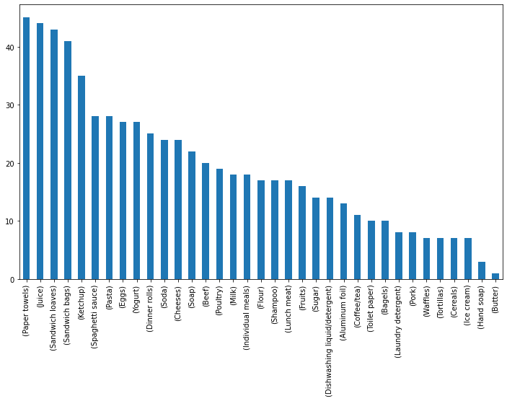
Possible Combos with Lucrative Offers
Possible Combos
INTERFACE:
“Paper Towels” were most recommended on purchased basket
“Butter” was least recommended on purchased basket

Slide 23
Possible Combos with Lucrative Offers
Possible Combos (Recommendation [9])
Purchased | Recommended
(Dinner rolls, Spaghetti sauce, Ice cream) | (Poultry)
(Cereals, Sandwich bags, Bagels) | (Cheeses)
(Eggs, Pasta, Ice cream) | (Paper towels)
(Eggs, Paper towels, Ice cream) | (Pasta)
(Laundry detergent, Spaghetti sauce, Poultry) | (Dinner rolls)
(Spaghetti sauce, Poultry, Ice cream) | (Dinner rolls)
(Aluminum foil, Yogurt, Toilet paper) | (Juice)
(Cereals, Dinner rolls, Spaghetti sauce) | (Poultry)
(Dinner rolls, Pasta, Paper towels) | (Eggs)
Combos –
Grocery store can provide a combo of Cereals, Sandwich bags, Bagels and Cheeses as they seems to have good lift.
Store can create a combo of Dinner rolls, spaghetti Sauce, Ice cream and Poultry.
Eggs, Pasta, Ice cream and Paper towels can be purchased as another combo.

Slide 24
Possible Combos with Lucrative Offers
Offers
On possible combos, grocery store can make an offer or discount
Grocery store can provide an offer of Cereals, Sandwich bags, Bagels and Cheeses. They have good lift.
An 5 or 10% discount can be made on Eggs, Pasta, Ice cream and Paper towels.
***Offers are subjected to monetary value basket holds and a better offer can be recommended if we would have more transactional data with product price.

Slide 25
THANK YOU
Hemant Patidar
patidarhemant27@gmail.com
PGPDSBA Online Sep_A 2021
26-06-2022

